Slide 1
Grafana and Monitoring Stack Workshop
Joshua Jose S. Endozo
DevOps Engineer

Slide 2
Table of Contents
Introduction to Grafana
Running Standalone Grafana
Exploring Grafana Interface
Understanding the Monitoring Stack
Running the Complete Stack

Slide 3
What is Grafana?
Open-Source Platform for monitoring and observability that allows you to:
Query data from various sources
Visualize metrics through customizable dashboards
Alert on conditions that matter
Understand your infrastructure at a glance

Slide 4
Why Grafana?
Multi-source support: Connect to Prometheus, InfluxDB, Elasticsearch, MySQL, and 100+ other data sources
Beautiful dashboards: Transform raw data into actionable insights
Community-driven: 10,000+ pre-built dashboards ready to import
Open source: Free to use, extend, and customize

Slide 5
Running Standalone Grafana
What We'll Do
Pull the Grafana Docker image
Run Grafana as a single container
Access the web interface
Explore the basic features
Clean up the container
Execute Part 1 of PARTICIPANT_GUIDE.md

Slide 6
Exploring Grafana Interface
Access Grafana UI: http://localhost:3000

Slide 7
Understanding the Monitoring Stack

Slide 8
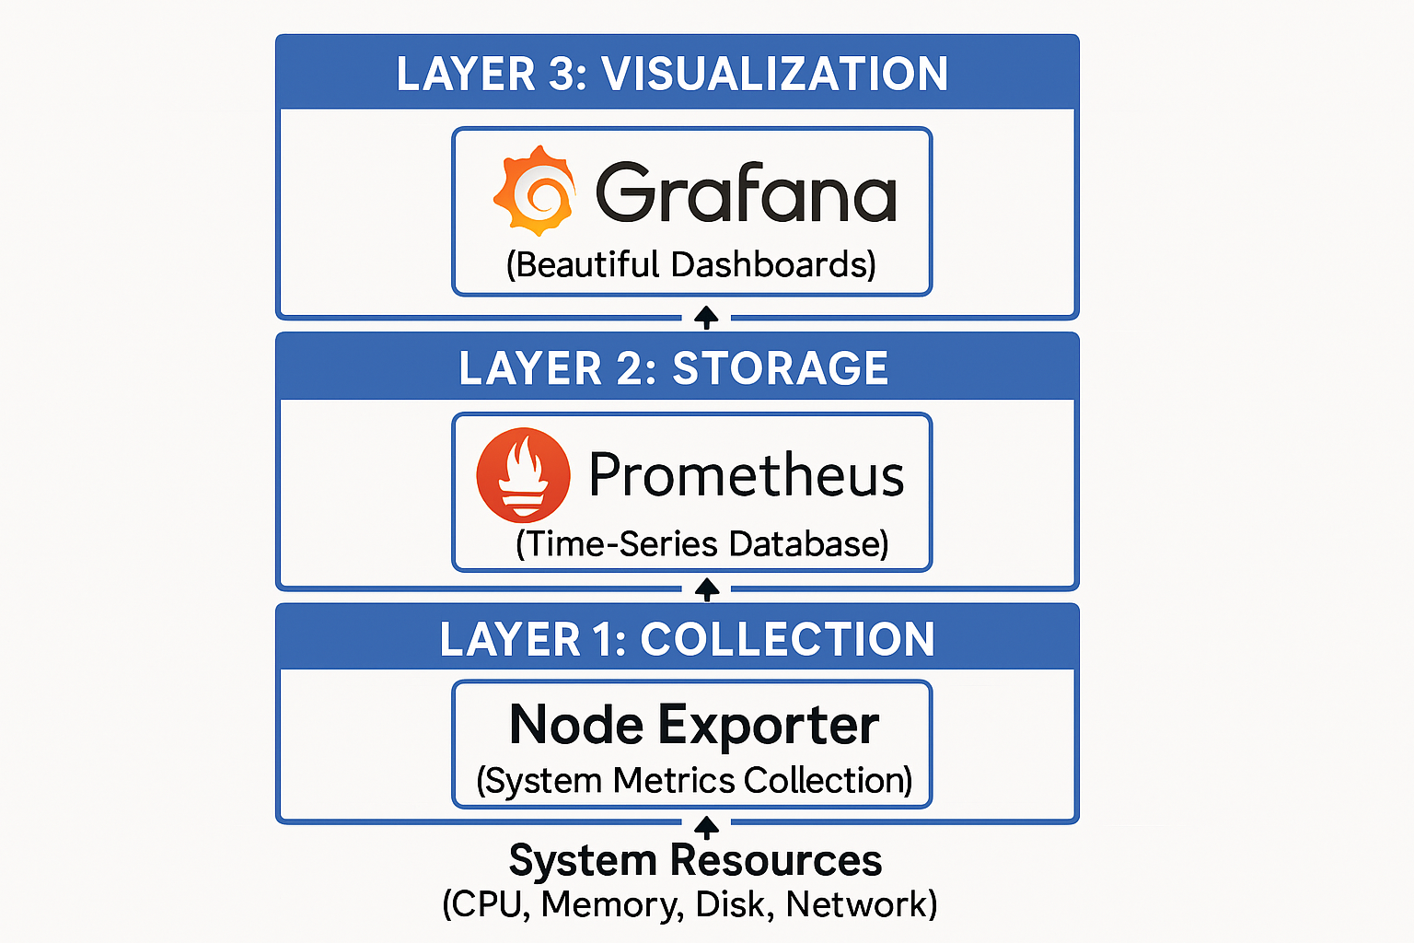
The Three-Layer Architecture

Slide 9
The Data FLow
1. Collection: Node Exporter reads system statistics from `/proc`, `/sys`, etc.
2. Exposure: Metrics exposed in Prometheus format at `http://node-exporter:9100/metrics`
3. Scraping: Prometheus pulls metrics every 15 seconds and stores them
4. Querying: Grafana sends PromQL queries to Prometheus
5. Visualization: Grafana transforms query results into graphs and dashboards

Slide 10
Why This Architecture?
Separation of Concerns: Each component does one thing well
Scalability: Can add more exporters without changing Prometheus or Grafana
Flexibility: Swap components (e.g., replace Grafana with other tools)
Industry Standard: Used by companies from startups to enterprises

Slide 11
Running the Complete Stack
Part 2 of PARTICIPANT_GUIDE.md

